Slide 1
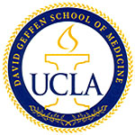
Impact of Mitochondria on Ischemic Heart Disease
By Tina Huang
High School Summer Intern 2012
Cardiac Proteomics and Signaling Laboratory
UCLA David Geffen School of Medicine
August 23rd, 2012

Slide 2
Outline
Epidemiology of Cardiovascular Disease
Cardioprotection and Preconditioning
Mitochondrial Biology
Role of Mitochondria in Ischemic Injury
Concluding Remarks

Slide 3
Epidemiology of Cardiovascular Disease (1 of 2)
Between 2010 and 2030, total direct medical costs of CVD are projected to triple, from $273 billion to $818 billion.
On average, more than 2,200 Americans die of cardiovascular disease each day – an average of 1 death every 39 seconds.
Cardiovascular Disease claims more lives each year than cancer, chronic lower respiratory disease, and accidents combined.
1 in every 3 deaths in the United States were caused by cardiovascular disease.
Each year, an estimated 785,000 Americans will have a new coronary attack
470,000 will have a recurrent attack.
Roger V L et al. Circulation 2011;123:e18-e209
Notes:
Link citation

Slide 4
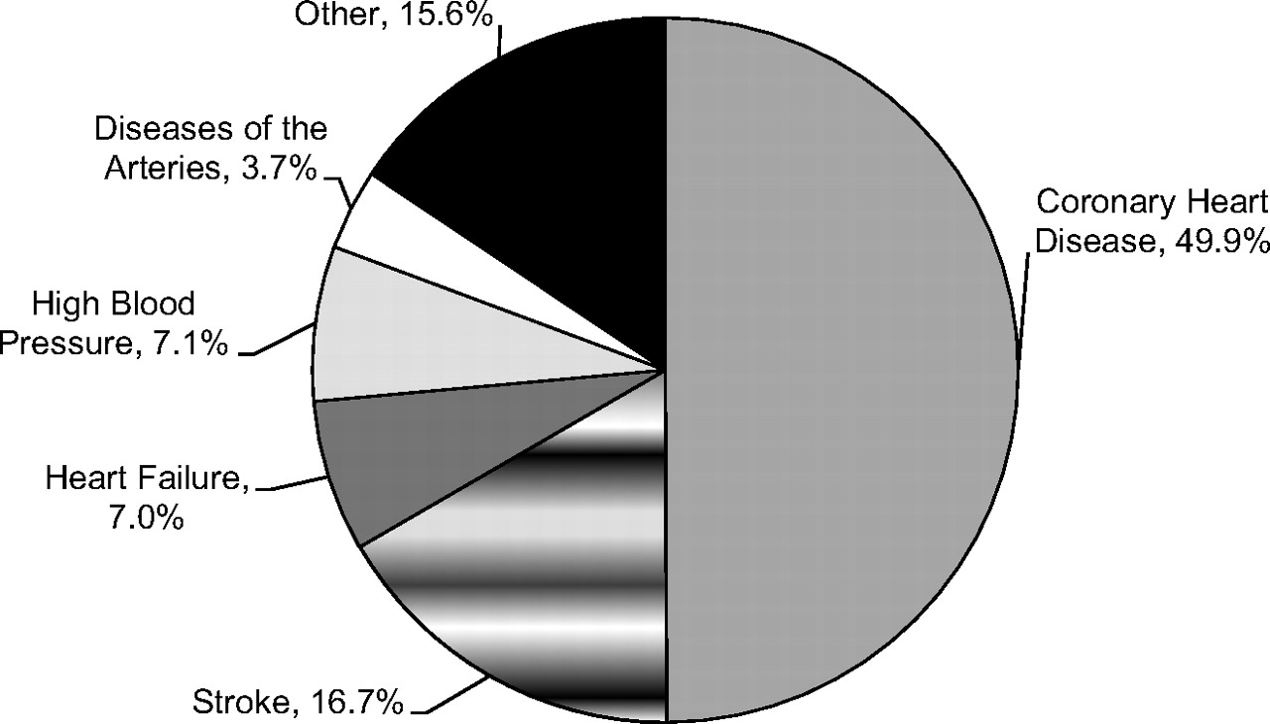
Epidemiology of Cardiovascular Disease (2 of 2)
82.6 Million American adults have one or more types of cardiovascular disease (CVD). Total CVD includes diseases listed below:
Coronary Heart Disease – 16,300,000 American adults
Heart Attack – 7,900,000
Chest Pain – 9,000,000
Heart Failure – 5,700,000
Stroke – 7,000,000
Percentage breakdown of deaths due to cardiovascular disease (United States: 2007).
Roger V L et al. Circulation 2011;123:e18-e209
Copyright © American Heart Association
Notes:
Percentage breakdown of deaths due to cardiovascular disease (United States: 2007). Source: National Heart, Lung, and Blood Institute from National Center for Health Statistics reports and data sets. *Not a true underlying cause. With any mention deaths, heart failure accounts for 34 percent of cardiovascular disease deaths. Total may not add to 100 because of rounding.

Slide 5
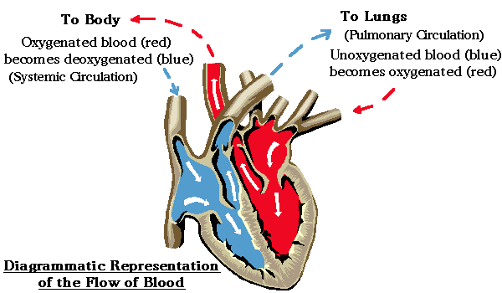
The Circulatory System
Pulmonary Circulatory System
Systemic Circulatory System
Heart → Body → Heart
Deoxygenated blood is pumped into the pulmonary arteries
After it is oxygenated, the blood flows back into the left ventricle through the pulmonary veins.
From there, a forceful muscular contraction of the heart’s cardiac muscle expels the oxygenated blood into the aorta.
The aorta pushes the blood into the body through a branching system of many smaller arteries.
Heart → Lung → Heart
Superior Vena Cava and Inferior Vena Cava deliver used blood to the right atrium
The tricuspid valve opens into the right ventricle
From there, blood enters the left/right pulmonary arteries and into the lungs
After the blood is oxygenated, the blood is pushed back into the right and left pulmonary veins
Pulmonary veins lead to the left atrium of the heart.
Blood is pushed into the aorta.
http://www.wisc-online.com/objects/ViewObject.aspx?ID=AP12704
Notes:
NEEDED?

Slide 6
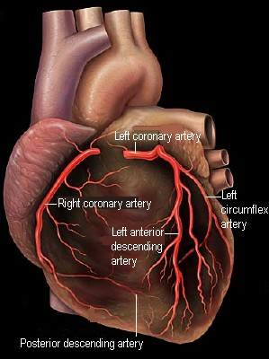
Coronary Arteries
Right Coronary Artery (RCA): Supplies the right ventricle wall
Left Coronary Artery (LCA): Branches to LCX and LAD
Left Circumflex Artery (LCX) : Supplies left posterior wall
Right Marginal Artery (RMA): Supplies right anterior
Diagonal Artery: Supplies left anterior
Left Anterior Descending Artery (LAD) : Supplies left anterior wall
Posterior Descending Artery: Supplies right and left posterior walls
Left Marginal Artery: Supplies left posterior
http://biology.about.com/od/anatomy/ss/Coronary-Arteries.htm
Notes:
Mention david heart cells , transition into what happens when they are occluded.

Slide 7
Cell Death
Apoptosis
Necrosis
and
A controlled, genetically programmed series of events in eukaryotic cells that leads to cell death (programmed cell death or cell suicide).
Function:
Destroy virus-infected or cancerous cells
Allows shaping of tissues and organs
Triggers:
External signaling molecules
Molecules within the cell that monitor potentially deleterious events.
During Apoptosis:
Cell shrinks
Bubbling of the surface into “blebs”
Breakdown of chromatin (DNA and protein)
Breakdown of mitochondria
Eventually, specialized cells called phagocytes engulf the cell - phagocytosis.
The premature death of cells in living tissue – caused by factors external to the cell or tissue.
Causes:
Inadequate nutrition – starvation.
Physical, biological, or chemical injury
Coagulation necrosis:
Accidental cell death typically caused by ischemia or infarction.
Architecture of dead tissue is preserved for several days.
Lack of lysosomal enzymes allow it to maintain a “coagulative” morphology
Liquifactive necrosis:
Transformation of tissue into a liquid, viscous mass.
Cell is completely digested by hydrolytic enzymes, leaving a soft lesion consisting of pus and the fluid remains of necrotic tissue.
"Apoptosis." World of Genetics. Gale, 2007. Gale Science In Context. Web. 6 Aug. 2012.
"Necrosis." World of Anatomy and Physiology. Gale, 2007. Gale Science In Context. Web. 6 Aug. 2012.

Slide 8
Reimer and Jennings
“This experiment was designed to answer two basic questions:
Will preconditioning the myocardium with four 5 min episodes of ischemia result in less necrosis from a sustained 40 min coronary occlusion when compared with that in animals subjected to only a single 40 min occlusion?
If so, will this protective effect extend through a 3 hr episode of sustained ischemia?”
Preconditioning with ischemia: a delay of lethal cell injury in ischemic myocardium.
C E Murry, R B Jennings, and K A Reimer
Circulation. 1986;74:1124-36, doi:10.1161/01.CIR.74.5.1124

Slide 9
The data presented show that brief, intermittent episodes of ischemia have a protective effect on myocardium that is later subjected to a sustained bout of ischemia. Indeed, when animals were subjected to a
sustained 40 min circumflex occlusion, those that were preconditioned suffered only one-quarter as much necrosis as that incurred by control "virgin" hearts. However, this protective effect served only to delay cell death; when the episode of sustained ischemia was extended to 3 hr, infarct size was not significantly different in control and preconditioned hearts.
Forty Minute Study
The protective effect of preconditioning was independent of major baseline predictors of infarct size—area at risk and collateral blood flow.
Average infarct size:
In control animals: 29.4% of the area of risk (AR).
In preconditioned hearts: only 7.3% of AR.
Transmural mean collateral blood flow was not significantly different.
Three Hour Study
Preconditioning failed to limit infarct size after 3 hours of sustained ischemia.
Average infarct size:
In the control group = 47.9% AR.
In the preconditioned group = 47.1% AR
Transmural mean collateral blood flow was not significantly different in the two groups.
Preconditioning with ischemia: a delay of lethal cell injury in ischemic myocardium.
C E Murry, R B Jennings, and K A Reimer
Circulation. 1986;74:1124-36, doi:10.1161/01.CIR.74.5.1124

Slide 10
Causes of Preconditioning
Ischemic Trigger (as demonstrated by Reimer and Jennings)
Ischemic Preconditioning (defined by Reimer and Jennings) was originally described as “a protective response of the heart to nonlethal short bursts of ischemia”
Remote Preconditioning
Ischemic trigger is in a different organ to protect the heart.
Pharmacological Triggers
“During the first window of protection, short episodes of preconditioning ischemia lead to the release of signaling molecules.”
Nitric Oxide—vasodilator. (known as nitroglycerin), and also known as EDRF (endothelium derived relaxing factor).
Adenosine—ultimately prevents cytochrome c loss.
Stress Hormones
Liem D A et al. J Appl Physiol 2007;103:2129-2136

Slide 11
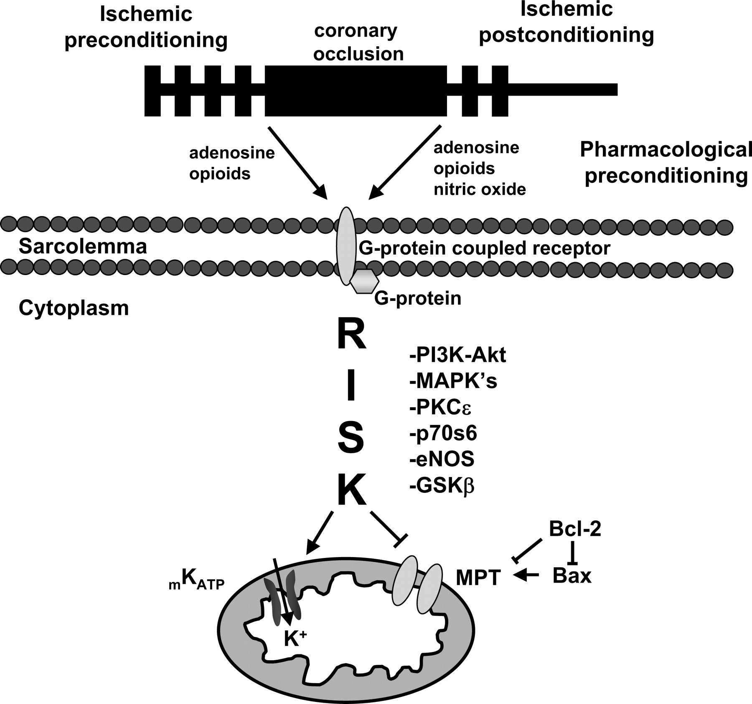
Preconditioning in the Mitochondria
Schematic presentation of the reperfusion injury salvage pathway (RISK) and the mitochondrial permeability transition (MPT) pore.
Liem D A et al. J Appl Physiol 2007;103:2129-2136
©2007 by American Physiological Society
Notes:
Schematic presentation of the reperfusion injury salvage pathway (RISK) and the mitochondrial permeability transition (MPT) pore. The phenomena of ischemic preconditioning, ischemic postconditioning, and pharmacological preconditioning can exert a cardioprotective effect against myocardial ischemia-reperfusion injury via the activation of G protein-coupled receptors followed by activation of the RISK pathway, which has been implicated to activate phosphatidylinositol 3-kinase (PI3K-Akt), MAPKs, PKCε, P70S6, endothelial nitric oxide synthase (eNOS), and GSKβ. Activation of the RISK pathway may initiate a protective effect through downstream inhibition of MPT and opening of mitochondrial K_{ATP} channels. The Bcl-2 family members may directly or indirectly, via inhibition of Bax, modulate the MPT pore. Modulation of mitochondrial K_{ATP} channels and the MPT pore may finally determine cell death by necrosis and/or apoptosis during myocardial ischemia and postischemic reperfusion.

Slide 12
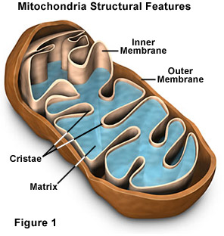
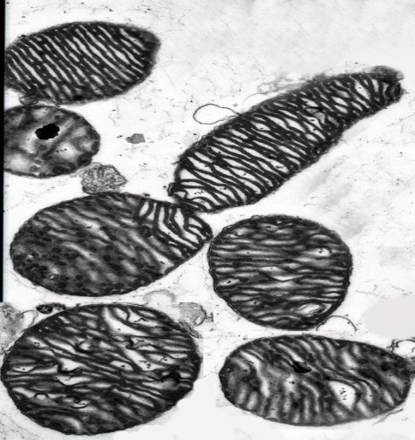
Mitochondria
Function:
Produce energy (ATP/ADP) for the cell.
Apoptosis
Bean-shaped or thread-like with average diameter of about 0.5 µm and length from 1 to 7 µm.
The number of mitochondria correlates with the cell’s level of metabolic activity
Skin and Muscle Cells
Murine Hepatic
Mitochondria
Murine Cardiac Mitochondria
http://ic.galegroup.com.ezproxy.bishops.com:2048/ic/scic/ReferenceDetailsPage/ReferenceDetailsWindow?failOverType=&query=&prodId=SCIC&windowstate=normal&contentModules=&mode=view&displayGroupName=Reference&limiter=&currPage=&disableHighlighting=false&source=&sortBy=&displayGroups=&action=e&catId=&activityType=&scanId=&documentId=GALE%7CCV2642150245#biol_03_img0290&userGroupName=bishops&jsid=4a4b3047cc54de6c472e10cfb18feb53
Notes:
The outer membrane contains a large number of proteins that form pores or channels through the membrane allowing small molecules to pass freely between the intermembrane space and the cytoplasm. These pores make the outer membrane permeable to most ions and small molecules; therefore, the intermembrane space has the same ionic composition as the cytoplasm surrounding the mitochondrion. The inner membrane is relatively impermeable and blocks the movement of ions and other small molecules. Both the inner and outer mitochondrial mambranes contain specific transport proteins that can move large molecules or ions across each by both passive and active transport. OntOnly those large molecules that have specific membrane transporters are able to enter mitochondria. This allows the mitochondria to create a unique biochemical environment within th ematrix to carry out the energy production reactions.

Slide 13
Pathophysiological Conditions During Ischemia
Na⁺/H⁺ Exchanger
Ischemia: an inadequate blood supply to an organ or part of the body, especially the heart muscles.
Mitochondrial Permeability Transition Pore (MPT Pore)
Normally beneficial—allows release of excess Ca²⁺
Excess Ca²⁺ causes extended opening of mPTP
Mitochondria swells and bursts.
Cytochrome C attracts caspase-9 and apaf-1
Forms the apoptosome
Triggers caspase cascade
Cleavage of chromatin
Calcium Uniporter
PTP
Na⁺/Ca²⁺ Exchanger
In the Mitochondria:
Hypoxia → No final electron acceptor, but ATP synthase pumps in protons for a brief period of time → pH in the matrix drops → Exchangers reverse.
Decrease in ATP and Increase in ADP
Increase of Carbon Dioxide
Oxford English Dictionary. http://www.oed.com/view/Entry/99924?redirectedFrom=ischemia#eid
Zhang J et al. Perspectives on: SGP symposium on mitochondrial physiology and medicine: mitochondrial proteome design: from molecular identity to pathophysiological regulation.
J Gen Physiol. 2012 Jun;139(6):395-406.
Notes:
With complex 4, oxygen is reduced to water. If you don’t have oxygen, you can’t complete the etc cycle. Without a functioning etc cycle, you can’t maintain the proton gradient (proton imbalance), and therefore atp synthase can’t work, and you can’t generate atp from adp.
Ischemia characterized by hypoxia, and hypoxia = no oxygen. No oxygen = no final electron acceptor (aka cannot be reduced to water). Because you don’t have oxygen, you can’t complete etc. Because you can’t complete etc, your proton gradient/electrochemical gradient is altered/changed/not the same. Therefore, changes the charge within the mitochondrial matrix, decreasing the ph inside the mitochondria for a certain period of time (that’s super small). This also leads to atp synthase disruption/stops protons from coming in.

Slide 14
Concluding Remarks
Cardiovascular diseases, particularly heart attacks, kill hundreds of thousands of Americans each year.
As regulators of ATP production and apoptosis, both of which are crucial in understanding heart disease, mitochondria play an enormous role in cardiovascular research.
Future directions for research may lie in further examining mitochondria on a cellular and molecular level.
Understanding MPTP
During my time here, I was able to explore the processes involved in cardioprotection and ischemic preconditioning.
Notes:
Summary of involvement of mitochondria in cardiovascular disease

Slide 15
Acknowledgements
Dr. Peipei Ping
Jun Zhang
David Liem
Amanda Lin
Caitie Black
X’avia Chan
Laboratory Members

Slide 16
References
"Mitochondria." World of Genetics. Gale, 2007. Gale Science In Context. Web. 17 Aug. 2012.
"Apoptosis." World of Genetics. Gale, 2007. Gale Science In Context. Web. 6 Aug. 2012.
"Necrosis." World of Anatomy and Physiology. Gale, 2007. Gale Science In Context. Web. 6 Aug. 2012.
Levine, B., Mizushima, N. & Virgin, H. Autophagy in immunity and inflammation. Nature 469, 323-335 (2011)
Zhang J et al. Perspectives on: SGP symposium on mitochondrial physiology and medicine: mitochondrial proteome design: from molecular identity to pathophysiological regulation.
J Gen Physiol. 2012 Jun;139(6):395-406.
Roger V L et al. Circulation 2011;123:e18-e20
http://www.wisc-online.com/objects/ViewObject.aspx?ID=AP12704
http://biology.about.com/od/anatomy/ss/Coronary-Arteries.htm
Preconditioning with ischemia: a delay of lethal cell injury in ischemic myocardium. C E Murry, R B Jennings, and K A Reimer. Circulation. 1986;74:1124-36, doi:10.1161/01.CIR.74.5.1124
Liem D A et al. J Appl Physiol 2007;103:2129-2136

