Slide 1


The Role of Proteins in Mitochondrial Study
Ravina Verma
Summer Intern 2012
Ping Lab

Slide 2
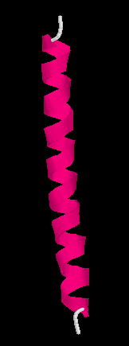
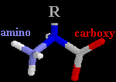
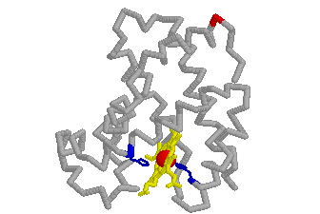
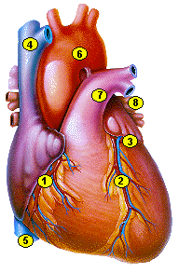
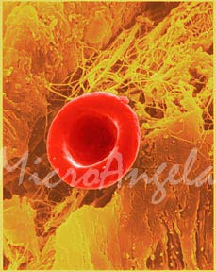
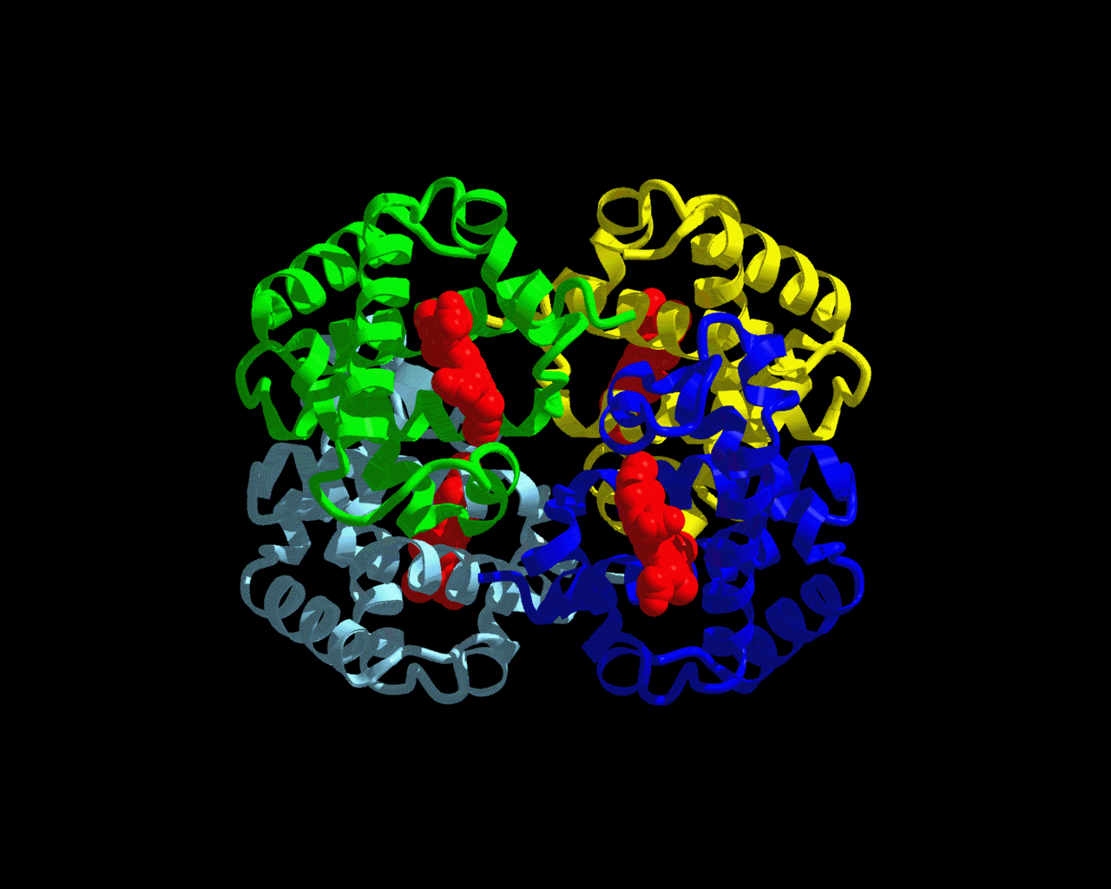
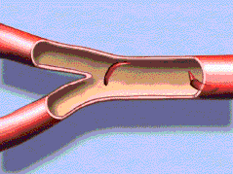
Protein: The Machinery of Life
NH₂-Val-His-Leu-Thr-Pro-Glu-Glu-
Lys-Ser-Ala-Val-Thr-Ala-Leu-Trp-
Gly-Lys-Val-Asn-Val-Asp-Glu-Val-
Gly-Gly-Glu-…..
“Life is the mode of existence of proteins, and this mode of existence essentially consists in the constant self-renewal of the chemical constituents of these substances.”
Friedrich Engles, 1878

Slide 3
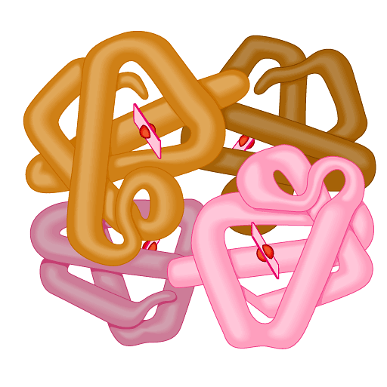
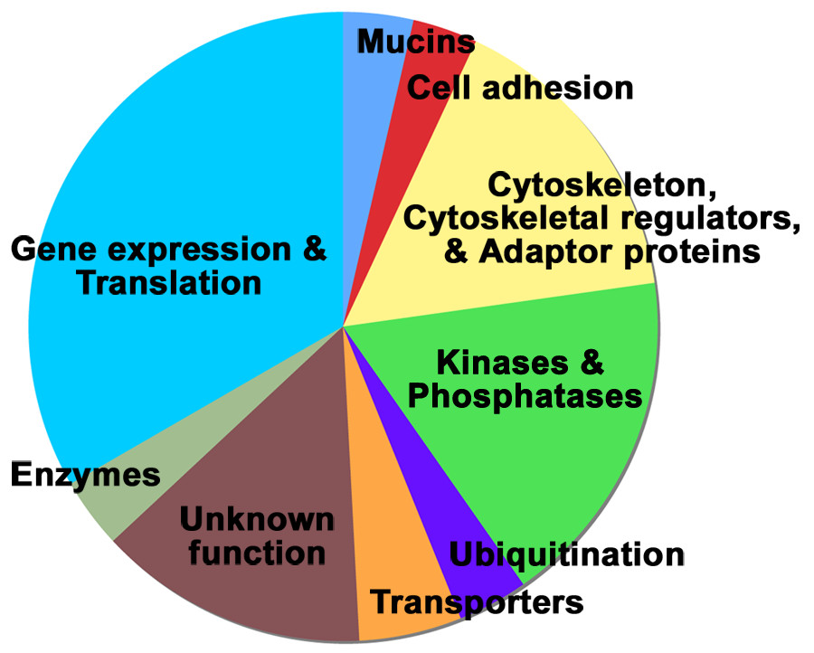
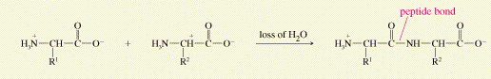
What are proteins?
Biochemical compounds consisting of one or more polypeptides and facilitate a particular biological function---- Folded into a fibrous or globular form.
Most structurally & functionally diverse group of biomolecules
Basic functions of a protein
  involved in almost everything
    Enzymes (lactase and pepsin)
    Structure (keratin, collagen)
    Antibodies
    Contraction (actin & myosin)
    Hormone (insulin & oxytocin)
    Storage (bean seed proteins)
    Carriers & transport (hemoglobin
    and cytochromes).
Notes:
Biochemical compounds consisting of one or more polypeptides typically folded into a globular or fibrous form, facilitiating a biological function.

Slide 4
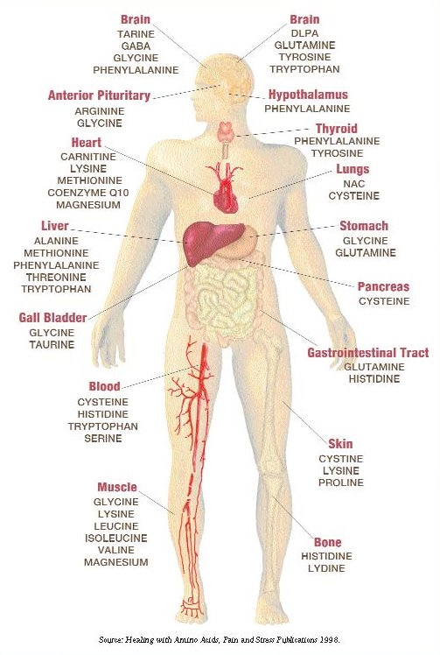
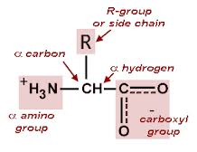
Amino acids
Amino acids play central roles as both building blocks of proteins and as intermediates of metabolism.
20 Amino acids are encoded by the universal genetic codes --- 9 essential amino acids
Distinguished by shape and general properties of their side chains.
Structure:
  central carbon
  amine group (base)
  carboxylic group (acid)
  R group (side chain)
    variable group
    confers unique chemical
    properties of the amino
    acid
General Formula
Notes:
Amino group = +
Carboxyl = -

Slide 5
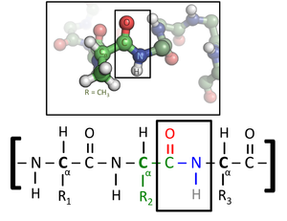
Peptides
Short polymers of amino acid monomers (<50 monomer units)
  Dipeptides: 2 amino acids
Peptide Sequence
  Composition – how many amino acids and their identity
  N terminal (First amino acid sequence)
  C terminal – (last amino acid in sequence) given by carboxypeptidase digestion.
N terminus
C terminus
Peptide Bond Formation

Slide 6
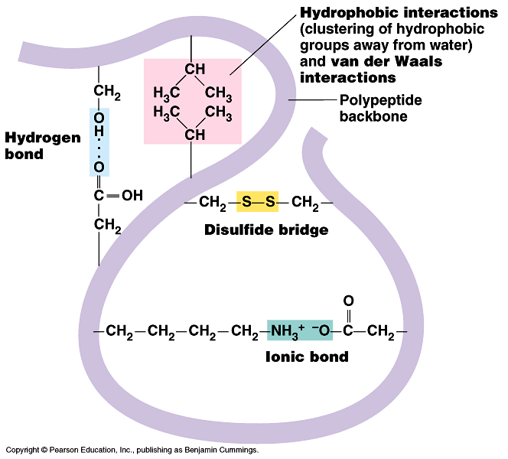
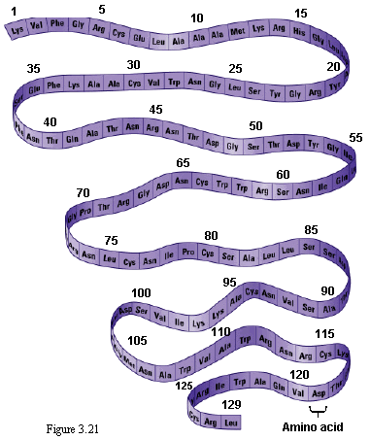
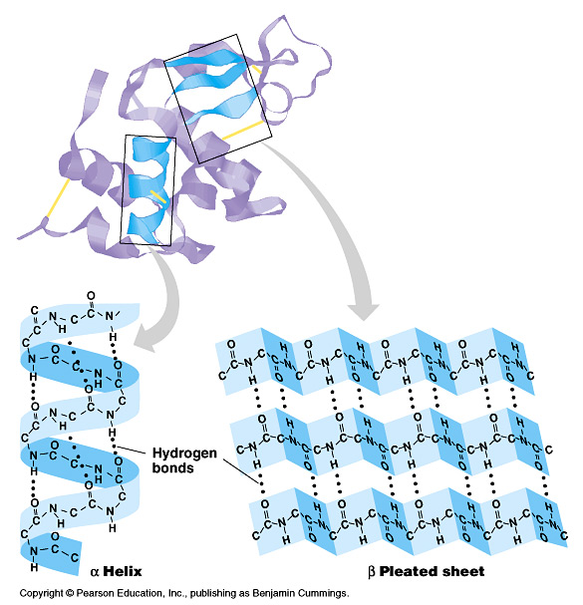
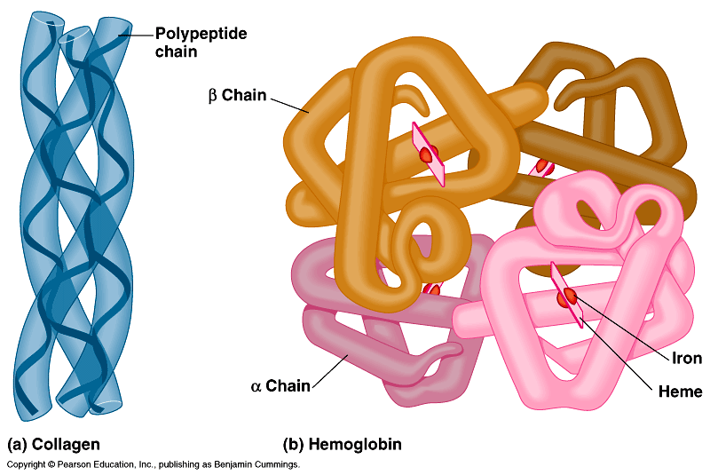
Protein Structure & Function
In molecular biology protein function is determined by structure
  Dependent on the order of amino acids (sequence)
Structural features of proteins are usually described at four levels of complexity:
Primary structure: Linear arrangement of amino acids in a protein and the location of covalent linkages such as disulfide bonds between amino acids.
Secondary structure: areas of folding or coiling within a protein; examples include alpha helices and pleated sheets, which are stabilized by hydrogen bonding.
Tertiary structure: Final three-dimensional structure of a protein, which results from a large number of non-covalent interactions between amino acids.
Quaternary structure: Non-covalent interactions that bind multiple polypeptides into a single, larger protein. Hemoglobin has quaternary structure due to association of two alpha globin and two beta globin polyproteins.
Primary
Tertiary
Secondary
Quaternary

Slide 7
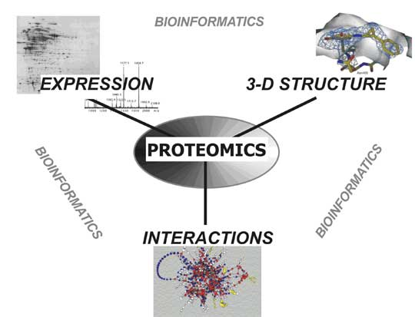
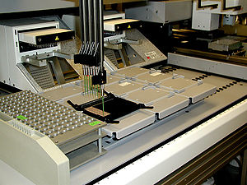

Molecular and Cellular Proteomics
Global study of the expression of genetic information at the protein level (proteome).
  It also deals with assessment of three-dimensional structure of proteins and their interactions
Proteome: Blend of “protein” and “genome”
Proteome includes entire compliment of proteins including the modifications made to a particular set of proteins, including the modifications made to a particular set of proteins.
Generally more complicated than genomics because proteome differs from time to time.
Scientists are very interested in proteomics because it gives a much better understanding of an organism than genomics.
          Protein Purification
          Mass spectrometry

Slide 8
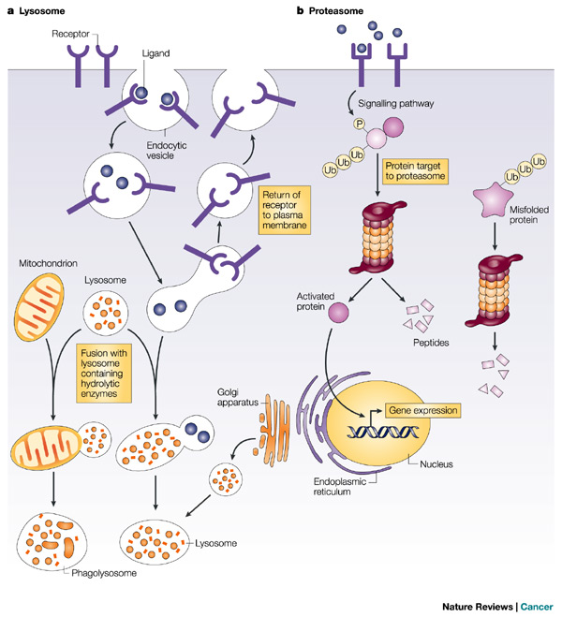
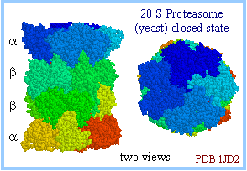
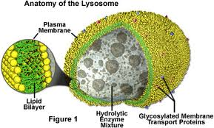
Pathways of Protein Degradation
Breakdown of proteins into smaller polypeptides or amino acids. Generally occurs by the hydrolysis of the peptide bond
  Most commonly achieved by cellular enzymes and proteases.
Degradation can be selective or non selective
Proteasomes: Mechanism by which cells
  regulate concentration of particular proteins/
  degrade misfolded proteins.
  Ubiquitin Proteasome Pathway
  Autophagy
  Lysosomal Proteolysis
    Receptor mediated endocytosis & phagocytosis

Slide 9
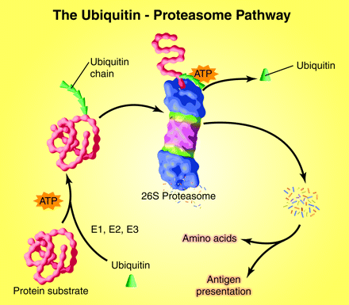
Ubiquitin- Proteasome Pathway
Major pathway of selective protein degradation in eukaryotic cells uses ubiquitin as a marker to target proteins for proteolysis.
Ubiquitin is a 76 amino acid polypeptide.
Proteins are marked for degradation by the attachment of ubiquitin to the amino group → More ubiquitin added create a multiubiquitin protease complex (Proteasome)
Ubiquitin is ultimately released to be reused in another cycle.
Both attachment of ubiquitin and degradation of marked proteins require energy in the form of ATP.

Slide 10
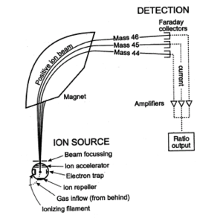
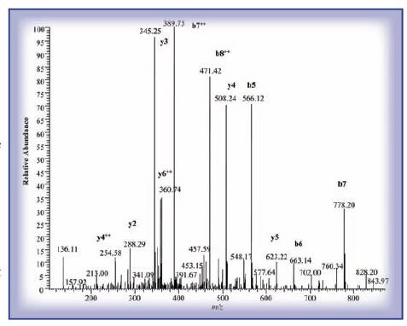
LC-MS/MS
Mass spectrometry (MS) is an analytical technique that measures the mass to charge ratio of charged particles. It is used to determine masses of particles, determine the elemental composition of a sample, and to elucidate molecular structure.
Protein is digested by proteolytic enzymes → smaller peptides and their precise molecular weights are measured using MS. The spectrum of those molecular weights is then compared with theoretical spectra from database.
Chooses the peptide which is then fragmented by the collision with inert gas.
  The fragmentation pattern gives either full of partial information about protein sequence that is subjected to the search in databases.
Allows for protein posttranslational modification analysis:
  Localizes given modifications within the protein and also helps to find out the nature of such modification.

Slide 11
High-throughput Measurement of Mitochondrial Protein Turnover by Heavy Water (²H₂O) Labeling

Slide 12
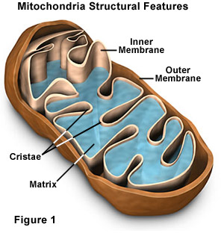
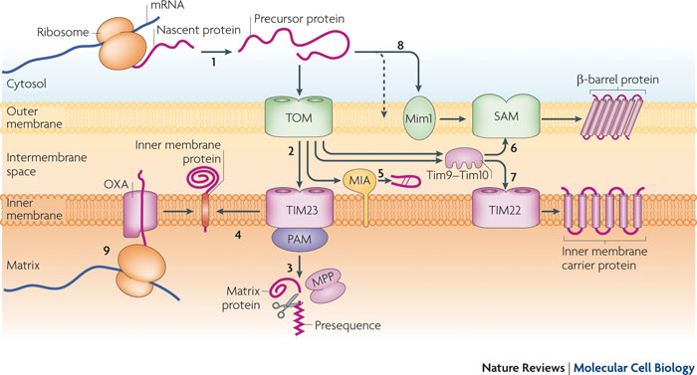
Mitochondria
Mitochondria play central roles in maintaining homeostasis in cells and their dysfunction is associated with a variety of diseases.
The integrity of mitochondrial functions necessitates delicate control of protein synthesis and degradation, or turnover.
To understand mitochondrial protein dynamics this experiment uses a metabolic heavy water (2H2O) labeling strategy customized to examine individual protein turnover in the mitochondria in a systematic fashion.
Notes:
What happens when your mitochondria are not working as they should?
Fatigue and weakness
Difficulty thinking, remembering, reasoning, etc.
Poor eyesight and digestion
Poor wound healing
•
Chronic illnesses
•
Low stamina
Allergies and asthma
Diabetes and obesity
Heart disease and certain cancers

Slide 13
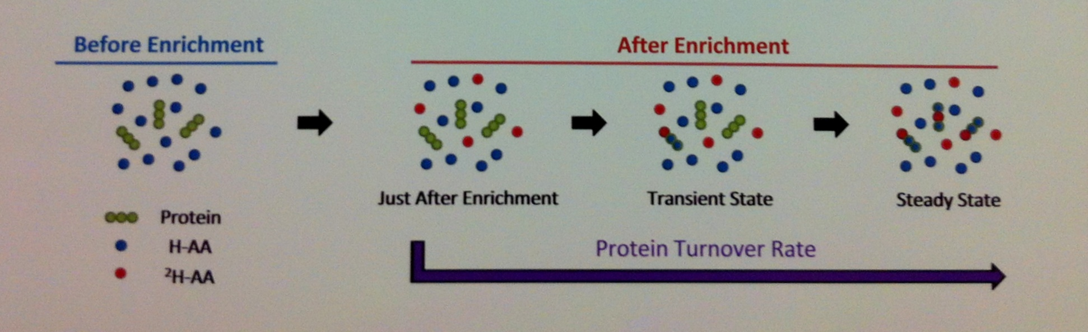
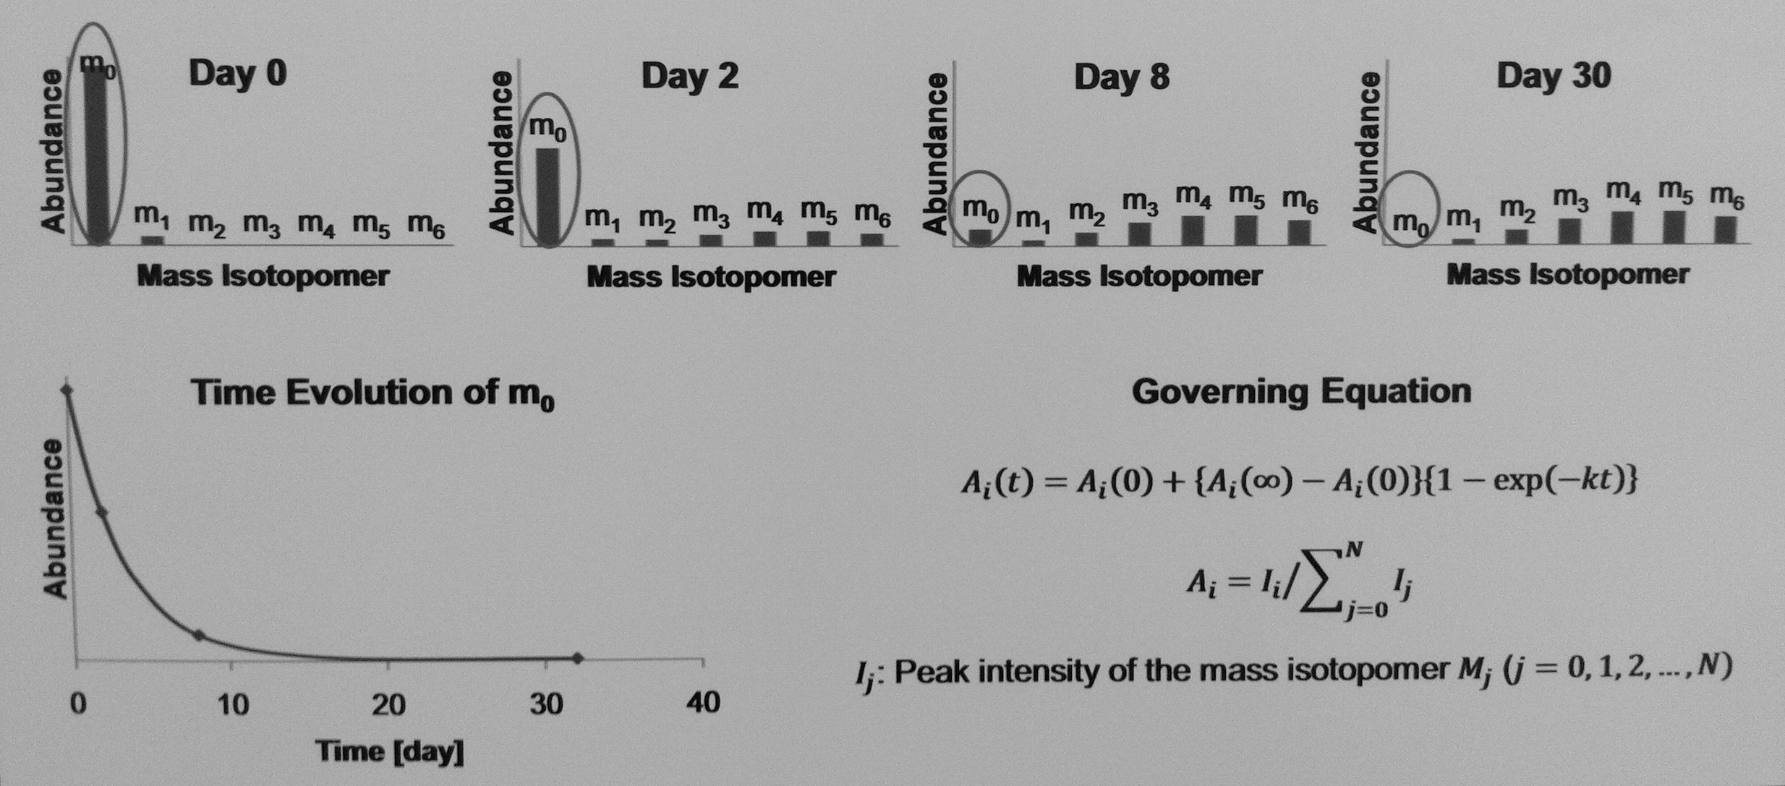
Experimental
Stable isotope labeling coupled with mass spectrometry has been widely exploited in studying dynamics of metabolites and protein.
Mice were fed with 2H₂O at a minimal level (<5% body water) without physiological impacts.
Incorporation of ²H Into Protein
Mitochondrial proteins were analyzed from 9 mice at each of the 13 time points between 0 and 90 days (d) of labeling.
A multi-parameter fitting approach computationally determines the normalized intensities of peptide mass isotopomers at initial and steady-state time points, and permits protein half-life to be determined.
Calculation of Protein Turnover Rate

Slide 14
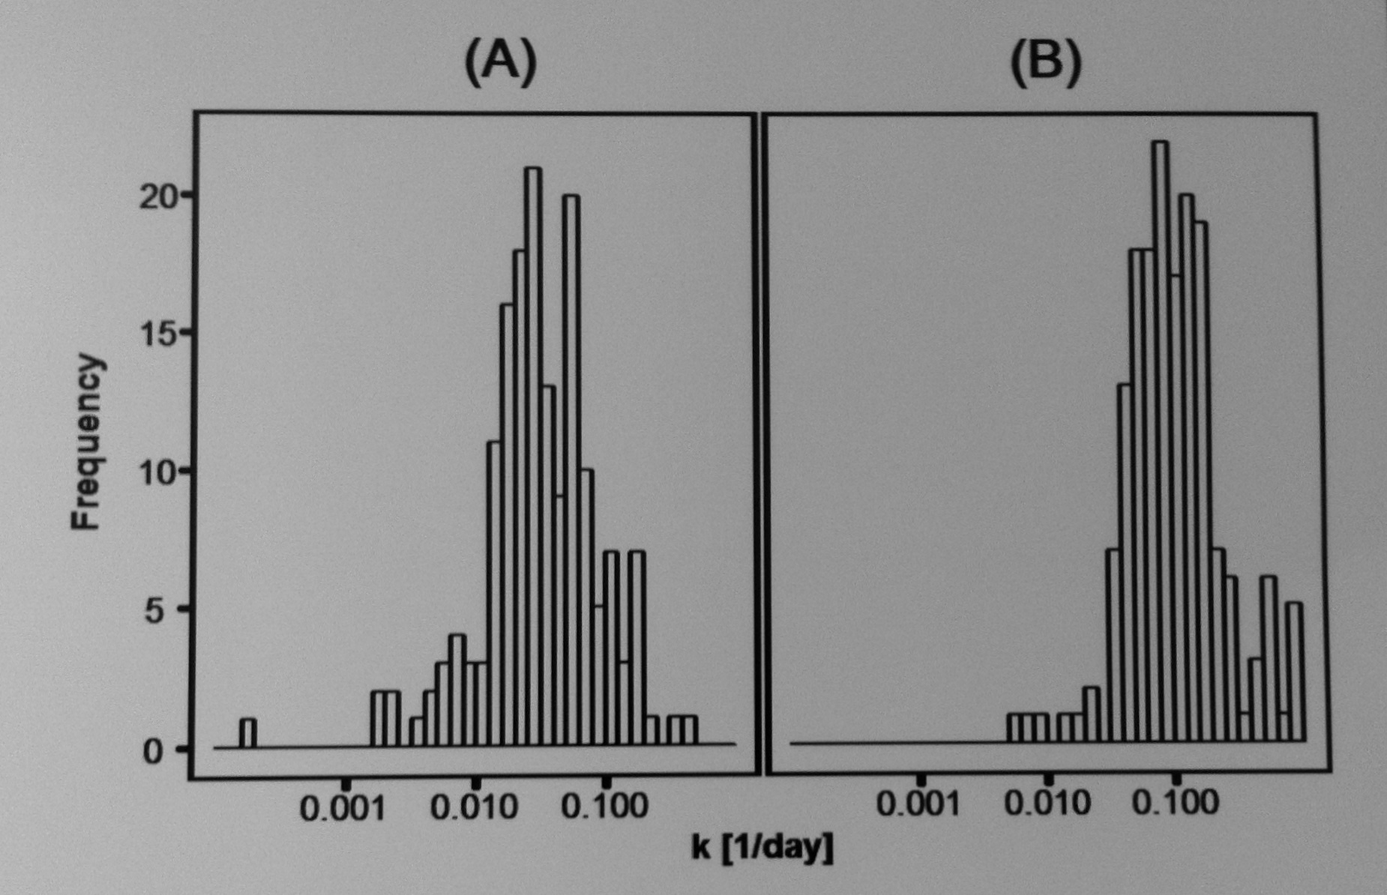
Distributions of Protein Turnover Rates
The median turnover rates from heart and liver proteins are 0.033 d⁻¹and 0.16 d⁻¹, respectively.
  This experiment characterizes the turnover rates of 458 proteins in mouse cardiac and hepatic mitochondria, with median turnover rates of 0.0402 d-1 and 0.163 d-1, respectively, corresponding to median half-lives of 17.2 d and 4.26 d.
Distributions of murine mitochondrial protein turnover rates from (A) heart and (B) liver clearly show that the proteins in the heart have slower turnover rates than those in the liver.

Slide 15
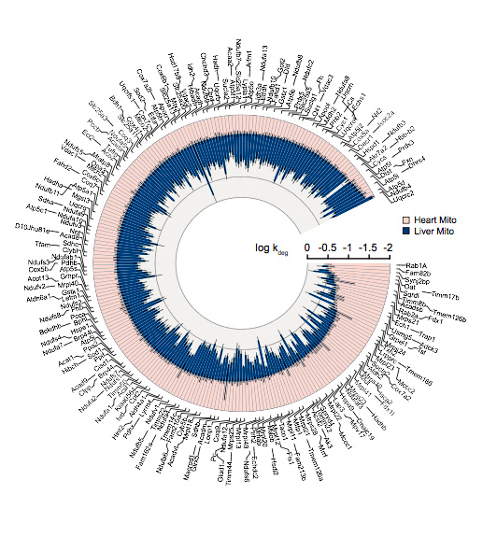
Half Lives of Mitochondrial Proteins from Murine Liver and Heart
Half-lives of murine mitochondrial proteins observed in liver and heart show that proteins in heart turn over more slowly than in the liver.
Mitochondria in the heart and those in the liver exhibited distinct turnover kinetics, with limited synchronization within functional clusters
Observed considerable inter-protein differences in turnover rates in both organs, with half-lives spanning from hours to months
Our proteomics platform demonstrates the first large-scale analysis of mitochondrial protein turnover rates in vivo, with potential applications in translational research.

Slide 16
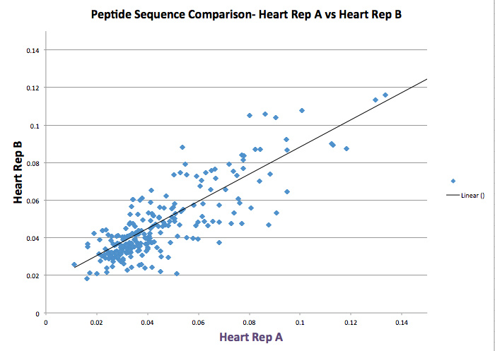

Slide 17
Conclusion
First mitochondrial proteome-wide study of in vivo protein dynamics.
Kinetic data will help elucidate the mechanisms of mitochondrial homeostasis.
Applications in the characterization of protein kinetics and temporal proteome changes in mammalian systems.
Human protein dynamics in clinical studies.

Slide 18
Acknowledgements
Dr. Peipei Ping
Jun Zhang
Allen Kim
Ding Wang
X’avia Chan
NHLBI Lab Members
Fellow Interns

