Slide 1
Advanced Heart Failure
Jung/Johnny Sin
Summer Intern 2012

Slide 2
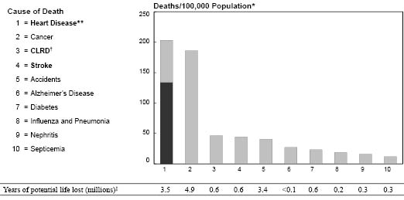
Epidemiology of Heart Disease
According to Center for Disease Control:
In 2008 over 616,000 people died of heart disease
25% of the people in the U.S. die of heart disease
According to American Heart Association:
Nearly 5 million Americans are suffering from CHF
Heart Failure contributes 287,000 deaths annually
According to World Health Organization:
Over 80% of CVD deaths take place in low-income countries.
cardiovascular disease is the leading cause of death
Cancer is the 2nd and chronic lower respiratory is 3rd
By 2030, 23.6 million people will die from CVDs
Heart Failure carries a high mortality rate often associated with
“sudden death”
Notes:
Find out the location (industrialized)
Yearly report (specific)
1st, 2nd, and 3rd leading causes

Slide 3
The Circulatory System
Circulatory System is an organ system that delivers nutrients and materials and also helps in the excretion of waste.
There are two types of the circulatory system:
Pulmonary: the blood travels from the heart to the lung through the pulmonary artery and back to the heart through the pulmonary vein. (small circuit)
Systemic: the oxygen-rich blood travels from the heart through the aorta to the rest of the body, which then travels back into the heart. (big circuit)

Slide 4
The Circulatory System (II)
The Passage of Blood Flow:
The blood enters the heart
The blood passes through the right atrium
From the atrium it enters the right ventricle and then leaves the heart.
The blood travels to the lungs as the first part of the pulmonary circuit.
In the lungs there is an exchange of gases
When the newly oxygenated blood returns to the heart it passes again through the left atrium and left ventricle.
The blood is then ready to be pumped out through the aorta into the systemic circuit.
http://img.docstoccdn.com/thumb/orig/43321851.png
Notes:
Carbon dioxide leaves

Slide 5
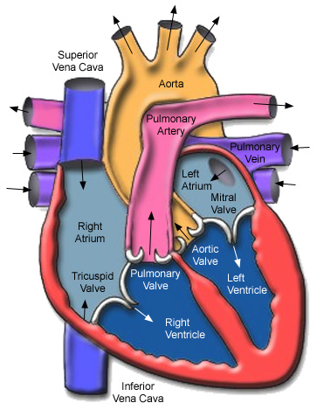
Anatomy of The Heart
The Heart has four chambers:
Two atria, and two ventricles
The heart is separated into two sides, left and right, by the septum.
The septum: (Interventricular septum) is a muscular wall separating the lower ventricles.
http://4.bp.blogspot.com/-V2vTl1xJ_Kc/Tn76DjIciqI/AAAAAAAAANg/oE27RRZ17WU/s1600/heart_anatomy.jpg

Slide 6
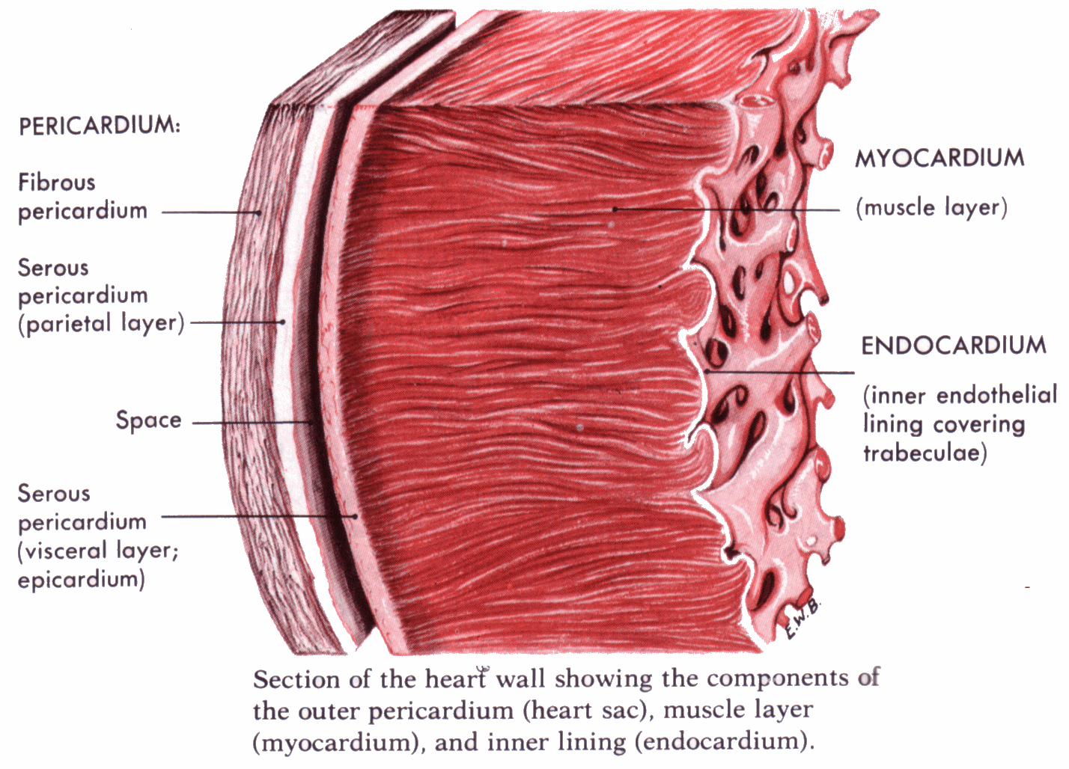
Ventricular Wall
The heart wall is consisted of three layers plus the pericardium which is a double-walled sac that protects the heart.
Endocardium: A thin layer of smooth muscles and the innermost layer. Consist of connective tissue.
Myocardium: The thickest layer of the wall and is the middle layer of the heart wall. Consist of muscle fibers that allow heart to contract.
Epicardium: The outermost layer that helps protect the heart. It is covered by connective tissue.
http://histologyolm.stevegallik.org/node/347
Notes:
Bold the words

Slide 7
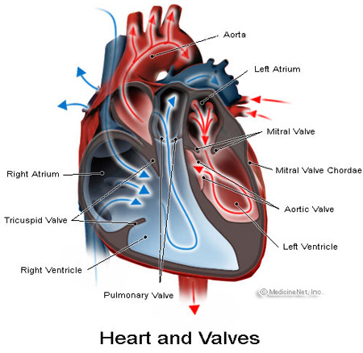
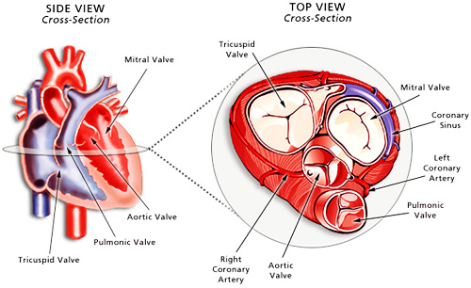
Heart Valves
One of the main functions of the valves is to ensure that the blood travel only in one direction
Each valve has leaflets to prevent backflow
Interestingly there are some people who are born with two leaflets per valve (bicuspid). However in the long term they are affected by this abnormality.
http://www.bing.com/images/search?q=Congestive+Heart+Failure&view=detail&id=C36A37BF2368BF496B6F0F917506A0A9C17864F7

Slide 8
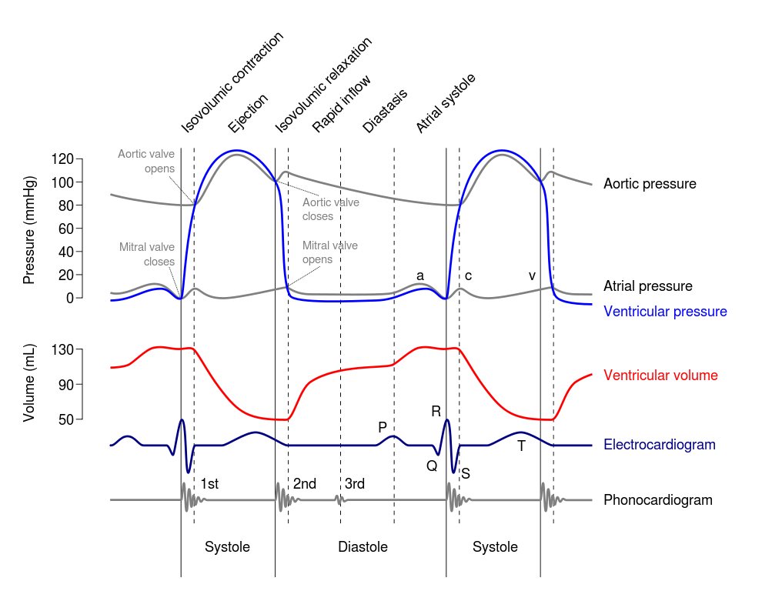
Cardiac Cycle
http://en.wikipedia.org/wiki/File:Wiggers_Diagram.svg
The cardiac cycle refers to any events related to the blood flow or blood pressure.
Explaining cycle:
The process is divided into systole and diastole.

Slide 9
Definition of Heart Failure According to NHLBI
“Heart failure is a condition in which the heart can't pump enough blood to meet the body's needs. In some cases, the heart can't fill with enough blood. In other cases, the heart can't pump blood to the rest of the body with enough force. Some people have both problems.”
“The term ‘heart failure’ doesn't mean that your heart has stopped or is about to stop working. However, heart failure is a serious condition that requires medical care.”
Also known as Congestive Heart Failure (CHF)
Notes:
Differentiate between types of Heart Failure

Slide 10
Four Stages of Heart Failure
Stage 1: The patient at high risk for heart failure, but has no heart abnormalities.
Stage 2: The patient has structural abnormalities of the heart, but no symptoms.
Stage 3: The patient has past or present symptoms associated with heart disease.
Stage 4: The patient has end-stage disease, requiring specialized treatment (e.g., continuous intravenous (IV) drug therapy, left ventricular assist device, heart transplant).
Notes:
Differentiate between types of Heart Failure

Slide 11
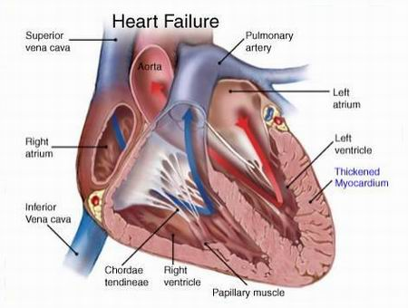
Etiology of Heart Failure
Ischæmic:
Caused by Ischemic Injury
Non-ischæmic:
Hypertension
Valvular Diseases
Familial
Idiopathic (unknown)
Congenital (Syndrome)
Heart failure is the most common outcome of cardiovascular diseases
http://heart-disease-symptoms.com/heart-failure-symptoms/
Notes:
Ischemic vs. Non ischemic.
Familial: an inherent disease (run in the family) muscle function is disturbed “out of the blood”

Slide 12
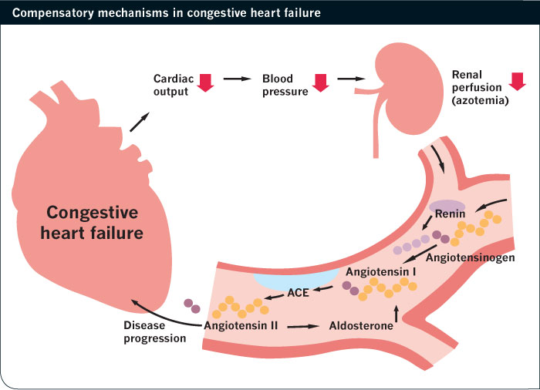
Neurohormonal System Response
Activation of Sympathetic Nervous System and the Renin-angiotensin-aldosterone system (RAAS) to compensate for low cardiac output state.
This will cause increased heart rate, myocardial contractility, maintenance of tissue perfusion pressure, and vasoconstriction to improve volume.
Renin-angiotensin-aldosterone system:
Kidney secretes renin which converts angiotensin, produced in the liver, to angiotensin I, which is also converted to angiotensin II.
Lead to the production of aldosterone which will
regulate reabsorption of salt and water.
Although these feedback mechanisms can improve
cardiac function, it will further ventricular
remodeling and chronically worsen HF.
Notes:
Ischemic vs. Non ischemic.
Familial: an inherent disease (run in the family) muscle function is disturbed “out of the blood”

Slide 13
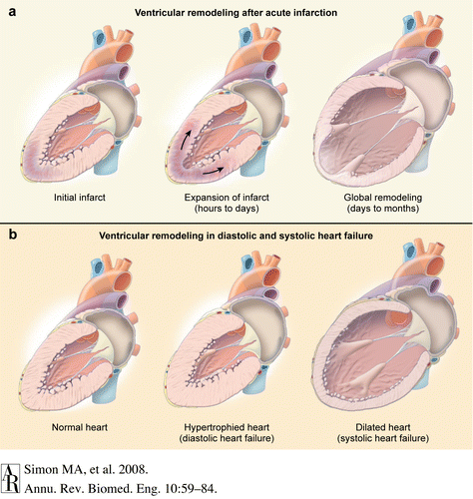
Left Ventricular Remodeling
Acutely leads to:
Chamber dilation
Progressive Ventricular Dysfunction
Notes:
Diastolic heart failure: cannot get enough blood since there is less space
Systolic heart failure: cannot contract since there is less myocardium

Slide 14
Mitochondria in Heart Failure
A large degree of patho-physiological changes in end-stage heart failure can be recovered in the process of reverse ventricular remodeling.
Ambardekar AV. Et al. Circ Res 2011
Cardiac energy deficiency plays an important role in the pathophysiology of heart failure
The heart produces and utilizes more energy than any other organs, and more than 90% of its energy is produced from mitochondrial respiration.
Failure to produce an adequate amount of energy causes mechanical failure of the heart
Neubauer S.N Engl J Med 2007; 356:1140-1151

Slide 15
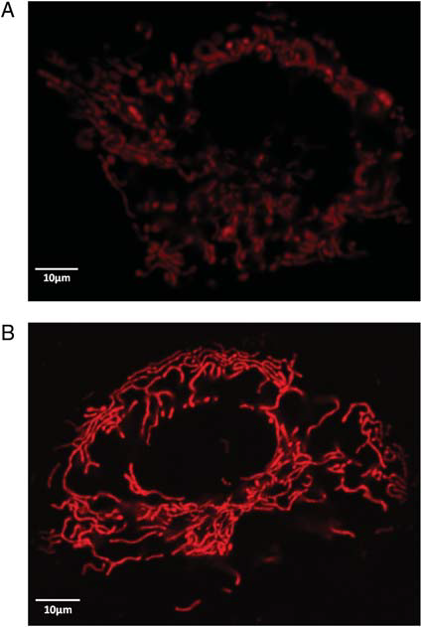
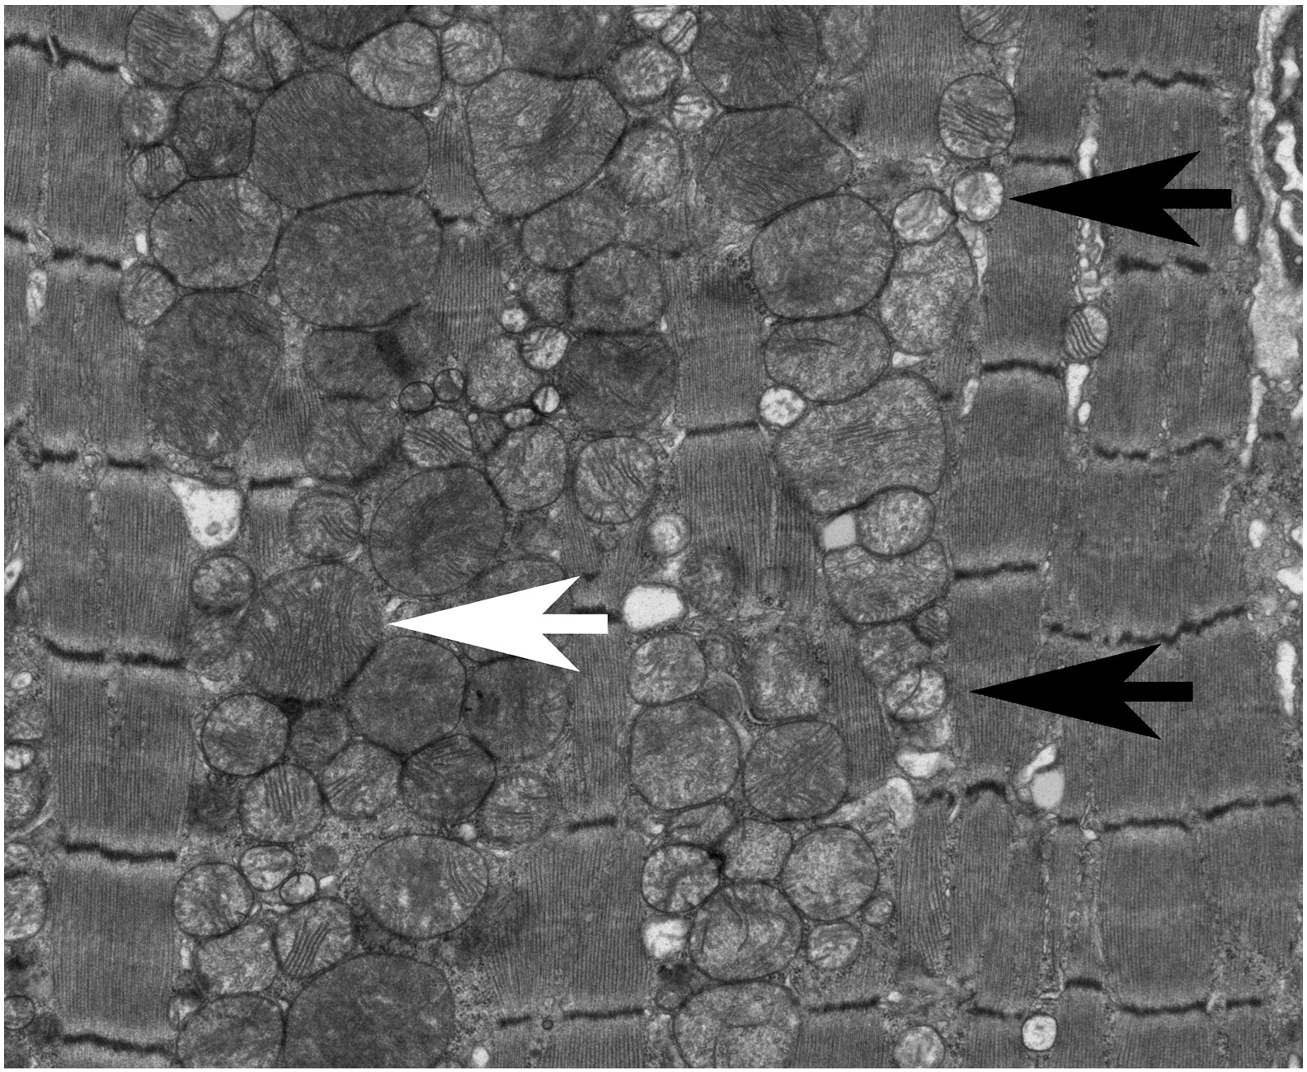
Mitochondria in Heart Failure
Fragmented and disconnected
Interconnected mitochondrial network
Mitochondrial dynamics in heart
disease by Gerald Dorn
The Mitochondria during heart failure are disorganized, fragmented, and small.
Also the number of mitochondria per area was significantly increased.

Slide 16
Current research on Mitochondrial Biology in Heart Failure
Oxidative Phosphorylation: A fundamental process of the mitochondria which contributes to the creation of ATP; however its capabilities are decreased in CHF.
The effect of mitochondrial morphology during heart failure is still unknown.
Fission: This process is coordinated with DNA replication.
Calcium overload, which is common in CHF, causes mitochondrial fragmentation in cardiomyocytes
Fusion: A merging method is highly protective that allows the mitochondria to tolerate high levels of mitochondrial DNA mutations (according to Caltech). This merging allows transport of materials and helps renew damaged functions of the mitochondria

Slide 17
Acknowledgements
Dr. Ping
David Liem
Laboratory People

Slide 18
Thank You
Thank You
Thank You
Thank You
Thank You

