Slide 1


Protein quantification and PTM
Jun sin Hss.i

Slide 2
Project 1

Slide 3
msms
MS analysis
Peptide Precursors
Fragmentation
Peptide sequence information
(on top of Mass and Charge)
MS/MS analysis

Slide 4
MS¹ v. ms²
Mass spectrometry can help to detect posttranslational modification.
MS is a tool for finding the molecular mass of a sample.
MS² or MS/MS uses two mass spectrometers in tandem that has some “form of fragmentation occurring in between the stages.”
MS/MS is used to produce structural information by identifying the resulting fragment ions.
The stages of mass analysis separation can be accomplished by a single mass spectrometer with the MS steps separated in time.

Slide 5
ms²
A peptide sequence tag obtained by tandem mass spectrometry can be used to identify a peptide in a protein database.
Peptide fragment ions are indicated by a, b, or c if the charge is on the N-terminus, and x, y, or z if the charge is maintained on the C-terminus.
Subscript indicates the number of amino acid residues in the fragment.
b₁
y₂₅

Slide 6
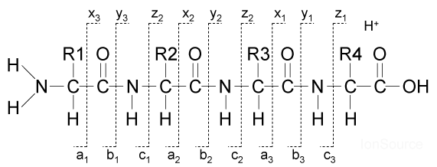
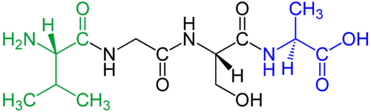
B ion and y ion
b₃
b₄
b₅
b₆
b₇
b₈
b₉
b₁₀
b₁₁
b₁₂
L L D E V F F S E K_{Ub} I Y K
y₁₂
y₁₁
y₉
y₈
y₇
y₅
y₄
y₃
y₂
The sequence of the peptide is determined by the mass difference between the peaks.
Confusingly, the y and b ions are intermixed; however, this mixing will help to establish a sequence, forward and backward.
The fragment peaks that appear to extend from the N-terminus are b ions.
N-terminus
C-terminus

Slide 7
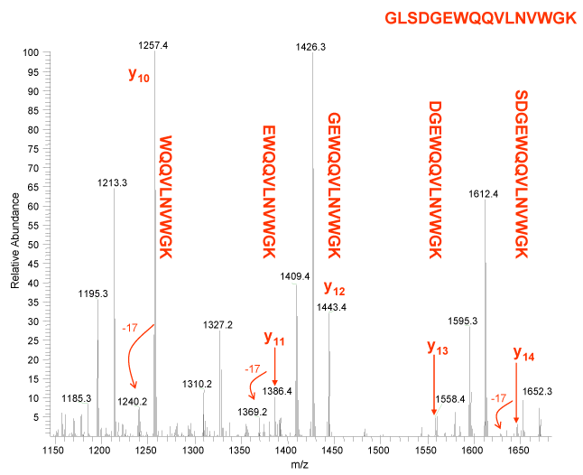
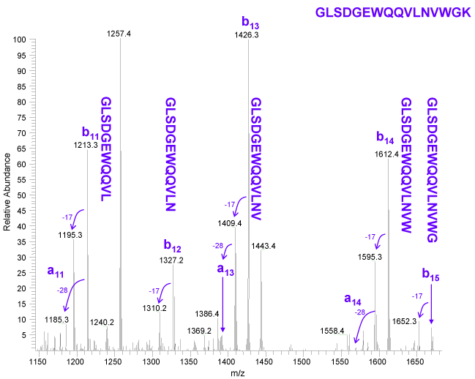
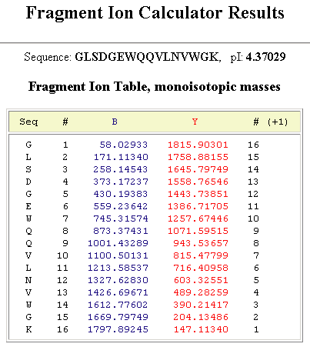
B ion and y ion
Groups of peptide fragment ions appear to extend from the C-terminus, these peaks are termed, y ion.
The b fragments peaks are labeled from the amino to the carboxyl terminus.
y ions being labeled in peptide GLSDGWQQVLNVWGK
b ions being labeled in peptide GLSDGWQQVLNVWGK

Slide 8
Information given from spectra
α3 Subunit
b₃
b₄
Xcorr = 3.04
z = 2
m/z = 872.96
0.7ppm
Xcorr: cross correlation
Z: charge state of precursor peptide
m/z: mass to charge ratio
ppm: accuracy of the precursor measurement
b₅
b₆
b₇
b₈
b₉
b₁₀
b₁₁
b₁₂
L L D E V F F S E K_{Ub} I Y K
y₁₂
y₁₁
y₉
y₈
y₇
y₅
y₄
y₃
y₂
100
1044.26
1118.33
80
1000.82
850.62
60
Relative Abundance
812.43
40
20
745.94
801.26
586.23
894.57
934.63
1217.88
1599.71
779.12
991.66
1079.59
1237.26
372.39
533.31
559.32
727.10
1159.64
1257.01
1397.84
289.20
344.30
415.92
525.32
972.19
1304.51
1356.65
1466.98
1578.95
1749.37
0
1692.13
400
600
800
1000
1200
1400
1600
m/z

Slide 9
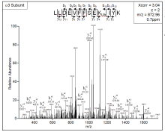
Procedure on labeling spectra
Main work
Remove unnecessary markings along the axis of the spectra
Outside Work
Clean up the spectra
Obtain the spectra from MS²
Incorporate into PowerPoint
Label spectra peaks with corresponding ion values
Subunit
m/z
Ppm
Xcorr
z
B ion
Y ion
OW
Receive data supplied by Uniprot and an Excel file
OW
Receive data supplied by Uniprot
Publication

Slide 10
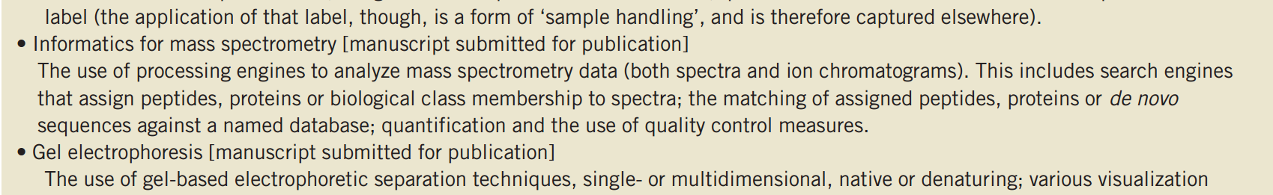
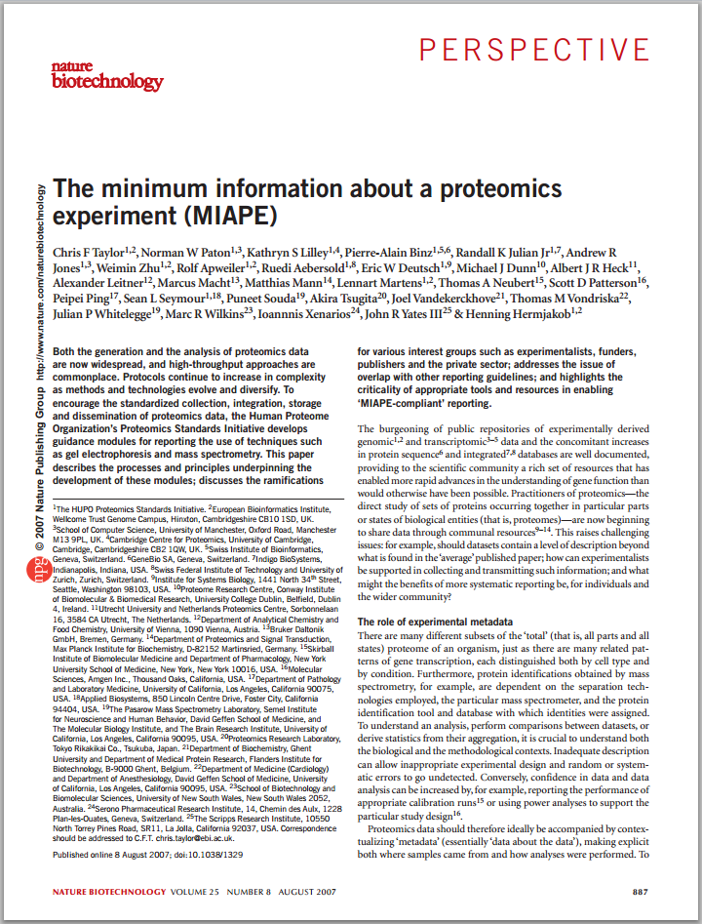
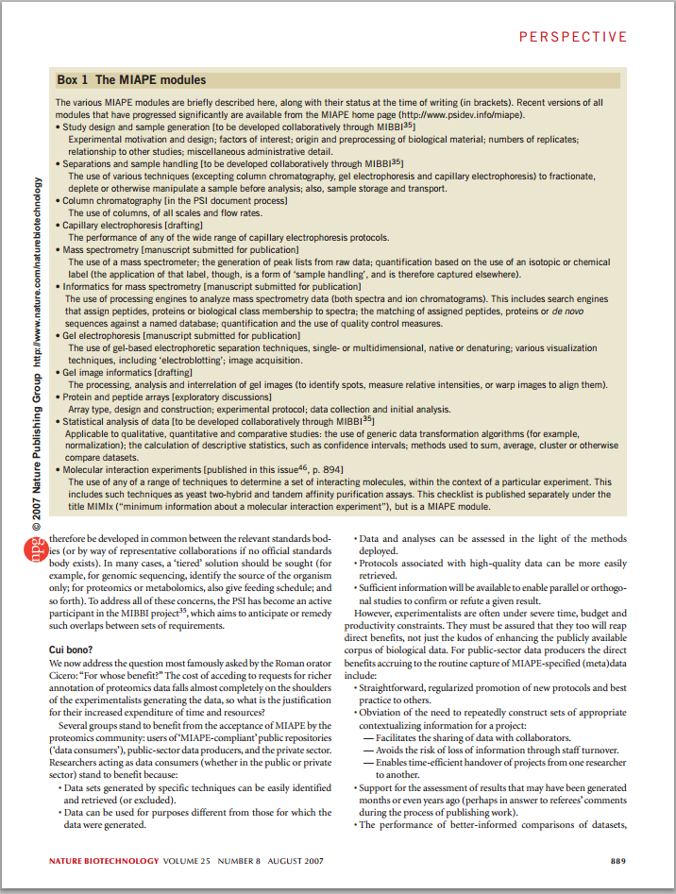


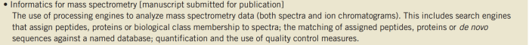
miape
The minimum information about a proteomics experiment
Nat Biotechnol. 2007 Aug;25(8):887-93
Cover page
3rd page of paper

Slide 11
Recap of spectra labeling
Spectra Labeled from Human | Spectra Labeled from Mouse
49 | 8
A labeled spectra produces a lot of information:
Xcorr (cross correlation)
m/z (mass-to-charge ratio)
z (charge)
ppm

Slide 12
Project 2

Slide 13
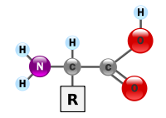
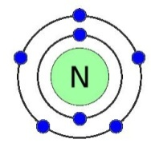

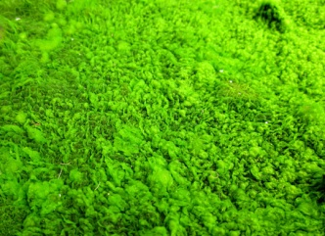
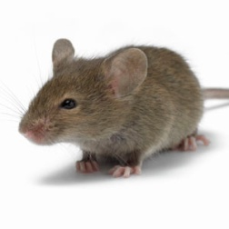

How to generate the internal standard
In order to find the differences between wild type and protected mice, nitrogen labeling was done.
The diet of the wild type contained ¹⁴N, while the IS mice had a specialized diet, in which all nitrogen was replaced with a heavy stable isotope, ¹⁵N.
Algae, the food for the mice, are able to produce proteins/amino acids (containing nitrogen-15) with the consumption of only ammonium.
When mice ingest the algae, they too produce amino acids and proteins labeled with ¹⁵N. The heavy nitrogen is found in the amine group of the amino acid.
¹⁵N-labeled Proteins
¹⁵N-labeled Amino Acids and Proteins
Ammonium
¹⁵N-labeled Algae
¹⁵N-labeled Mice

Slide 14
Internal Standard
Although most of the proteins in the IS mice are labeled with ¹⁵N, the process does not label 100 percent of the nitrogen.
There is about 15 percent ¹⁴N left, which accounts for the wide spread of the peaks.
With an additional 8 more weeks, the labeling will approach 100 percent.
Dihydrolipoyllysine acetyltransferase
(PKC Tg vs. WT equals 0.6)
GLETIASDVVSLASK
PKCε Tg
100
80
Internal Standard
Relative Abundance
60
40
20
0
745
747
749
751
x10
753
755
WT
m/z
100
80
Internal Standard
Relative Abundance
60
40
20
0
745
747
749
751
753
755
m/z
x10

Slide 15
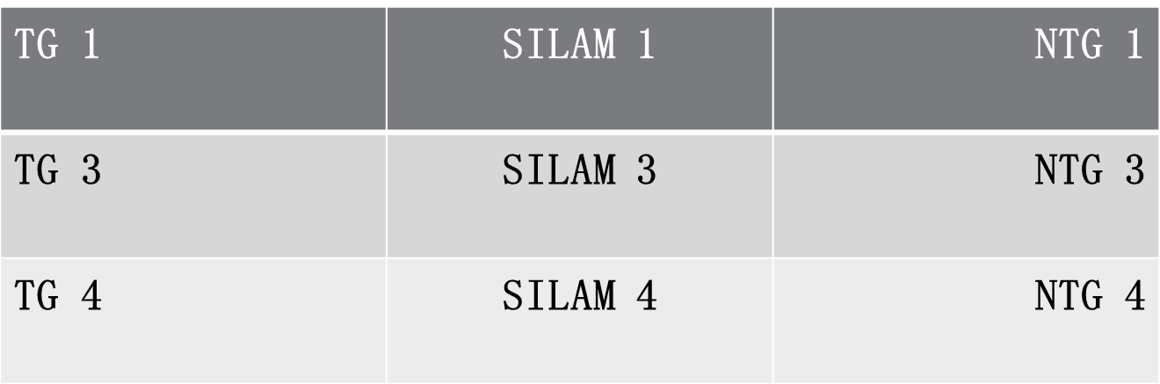
THE Silam project
The purpose of this project is to compare the protein expression of transgenic and nontransgenic mice.
However, the regression ratio between TG and NTG mice cannot be calculated directly, a reference point (SILAM mouse) is used for the calculation.
The experiment analyzed three SILAM, three TG, and three NTG mice.
Ratio 1
Ratio 2
Ratio 3
Ratio 4
Ratio 5
Ratio 6
Three Final Measurements

Slide 16
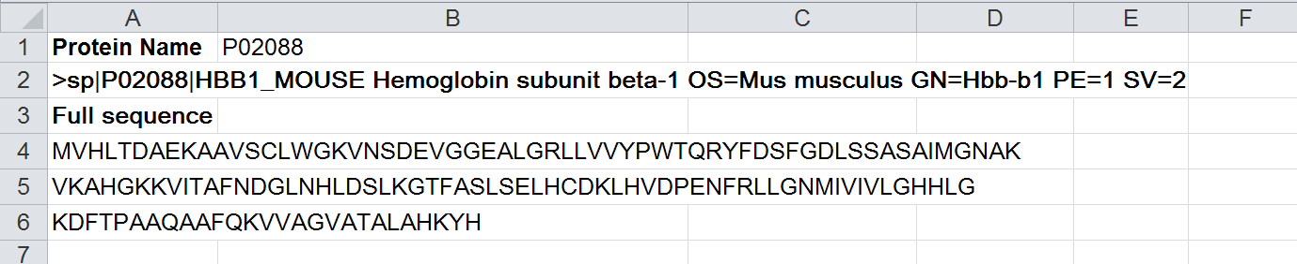
Protein Information
Supplied by www.uniprot.org
Protein Name and sequence of P02088

Slide 17
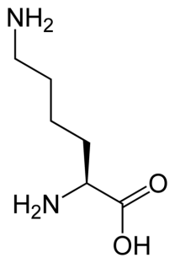
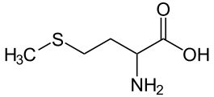
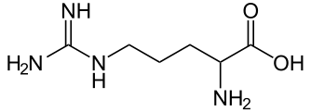
Quality of the peptide
Before starting the actual comparison, a quality check needed to be done.
The amino acid Methionine (M) was highlighted (disregarded) because of its susceptibility to oxidation of varying degrees.
Since trypsin cleaves proteins after Lysine (K) and Arginine (R), if K or R appeared in the middle of a peptide, a miscleavage occurred.
If R or K appeared at the beginning of a sequence (…RK…KR…KK…RR…), then it was a miscleavage, because of its ambiguity.
Also every peptide had to end in a K or a R.
When R or K appeared at the beginning of a sequence, or if K or R appeared in the middle of a peptide.
Methionine

Slide 18
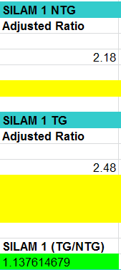
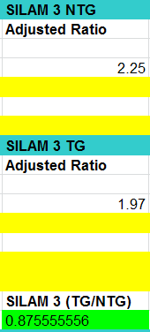
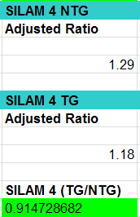
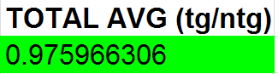
Calculating the ratios
Once all six adjusted ratios have been calculated, the TG/NTG ratios can be calculated.
The 4th and final “green box” is used for the average calculation of all three TG/NTG Ratios.
The average ratio after all three SILAM ratios have been found.
Final TG/NTG ratio for the protein D3Z3F4

Slide 19
Results of the Silam Project
With the final data, I was able to find the proteins that underwent no-change and change.
The proteins that changed either displayed up regulation or down regulation.
All proteins were counted and separated:
Proteins that underwent no-change | Proteins that changed: up regulation | Proteins that changed: down regulation | Proteins that were unsuitable for quantification
166 | 76 | 24 | 21
Total changed: 100
Total: 287

Slide 20
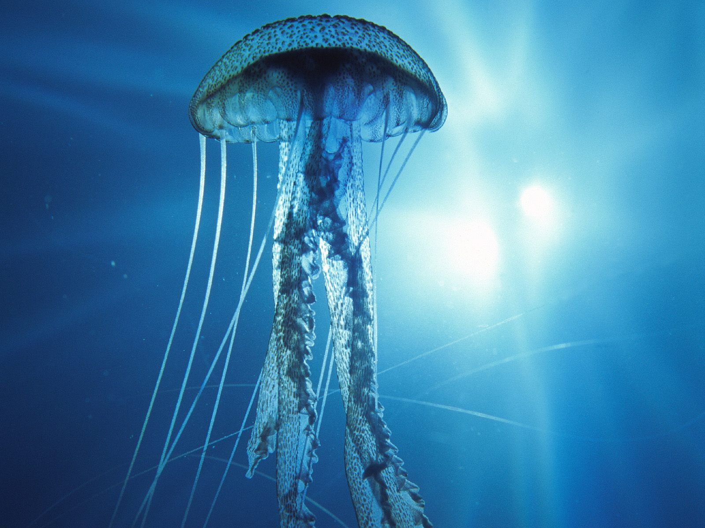
acknowledgements
Dr. Ping
Nobel Zong
Laboratory Members

Slide 21

Thank you
For everything

